Slide 1

Summer Training Presentation ON E-commerce Website Development (E-Store)
Submitted By:
Name : Kamlesh Yadav
University RollNo : 181500304
GLA University
Mathura-281406
(U.P.) INDIA

Slide 2
ESTABLISHMENT OF COMPANY:
Internshala is an internship and online training platform, based in Gurgaon, India.
Founded by Sarvesh Agrawal, an IIT Madras alumnus, in 2010, the Internshala platform, started out as a WordPress blog.
Internshala launched its online trainings in 2014. As of 2018, the platform had 3.5 million students and 80,000 companies.

Slide 3
OBJECTIVE OF TRAINING:
INTRODUCTION
The main reason for selecting this web development course was that it is able to describe the structure and functionality of all coding required for front-end and back-end.
Also, the web development field is getting popular because it is always evolving and constantly changing.
It becomes interesting to work with new tools and learn new skills.

Slide 4
LANGUAGES:
Front-End web development :
HTML
CSS
BOOTSTRAP
Back-end web development :
SQL
PHP
TOOLS:
Windows 10
Apache Netbeans IDE 11.3
WAMP
Google Chrome

Slide 5
1.HTML : Hypertext Markup Language is the standard markup language for creating web
pages and web application.
2. CSS : CSS is cascading style sheet which is used to give designer look to HTML using the
external file.
3. BOOTSTRAP : Bootstrap is a potent front-end framework used to create modern websites and webapps.
4. SQL : SQL is a structured query language used for querying database.
5. PHP : Hypertext Preprocessor is a server-side scripting language designed for web development but also used as a general-purpose programming language.

Slide 6

What is E-commerce:
Ecommerce, also known as electronic commerce or internet commerce, refers to the buying and selling of goods or services using the internet, and the transfer of money and data to execute these transactions.

Slide 7
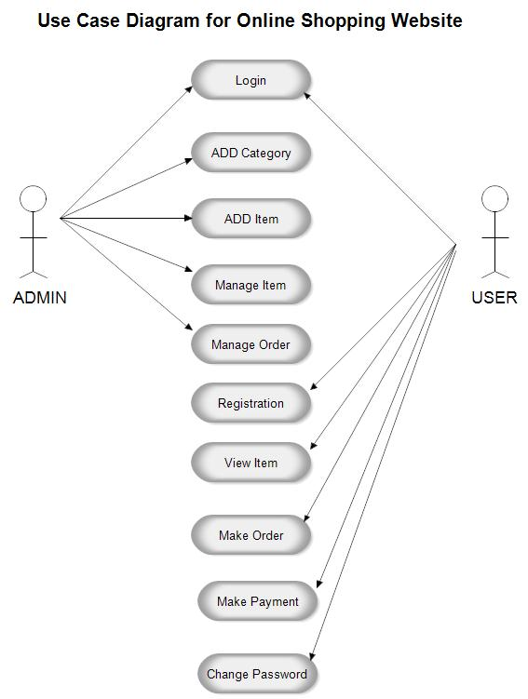
USECASE DIAGRAM :

Slide 8
FEATURES OF WEBSITE:
Index Page
About Us Page
Contact Us Page
Signup Page
Home Page
Settings Page
Cart Page
Success Page

Slide 9

HOME PAGE

Slide 10
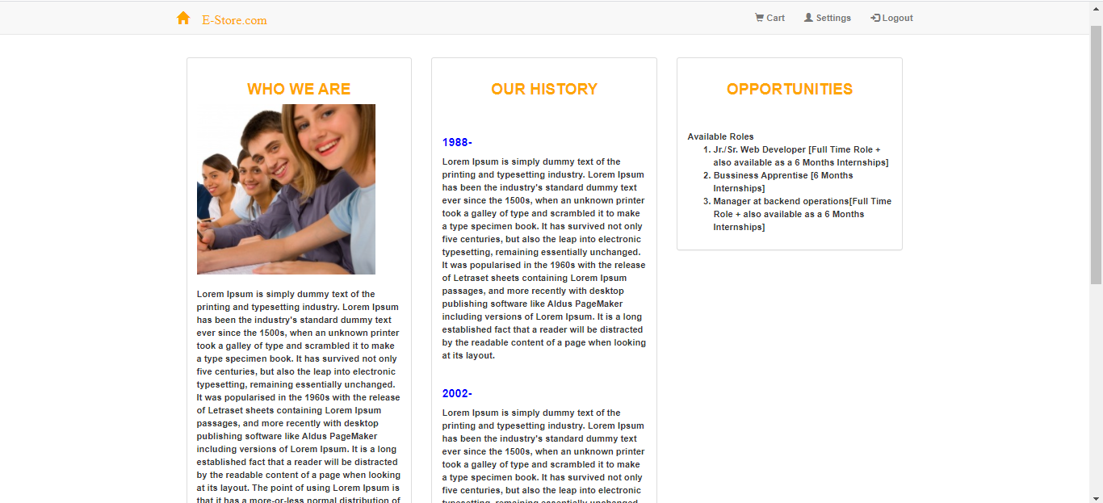
ABOUT US PAGE:

Slide 11
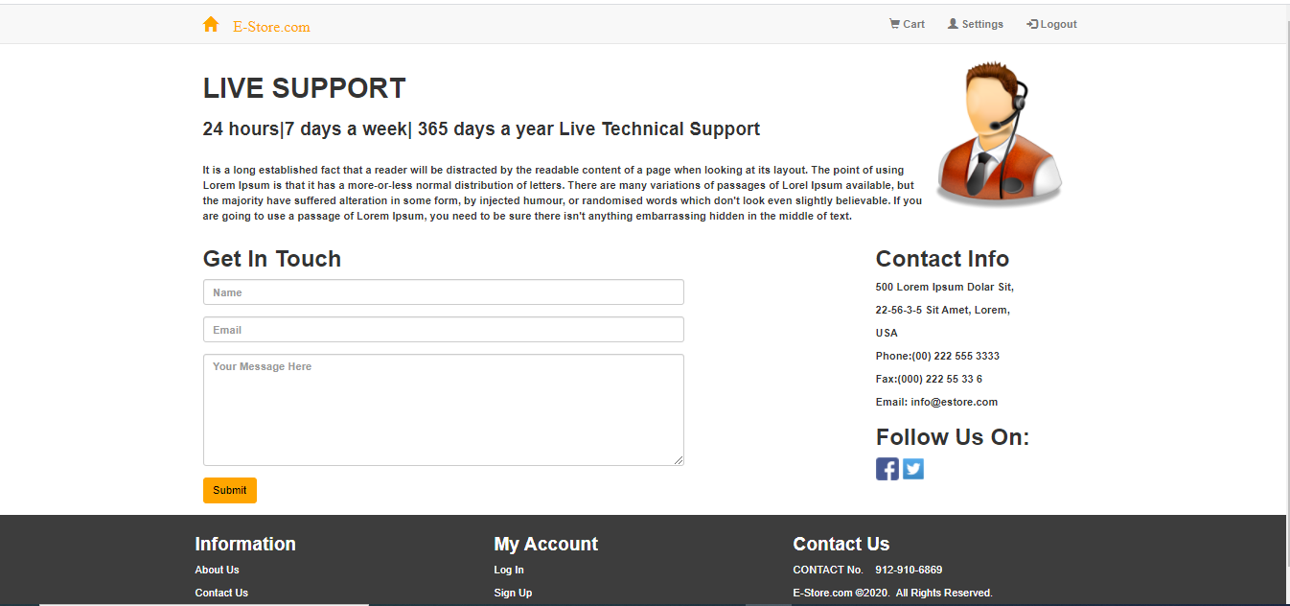
CONTACT US PAGE:

Slide 12
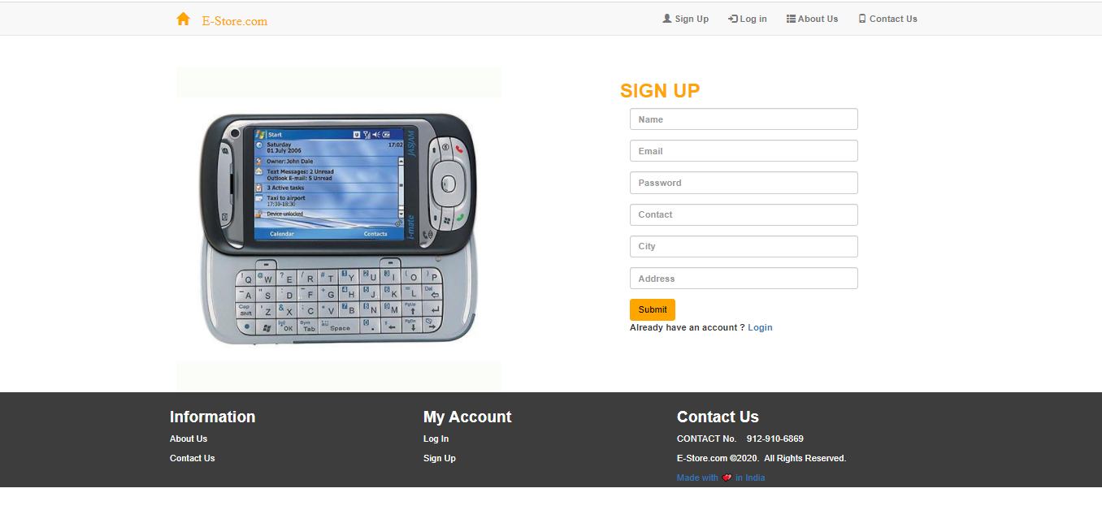
SIGNUP PAGE:

Slide 13
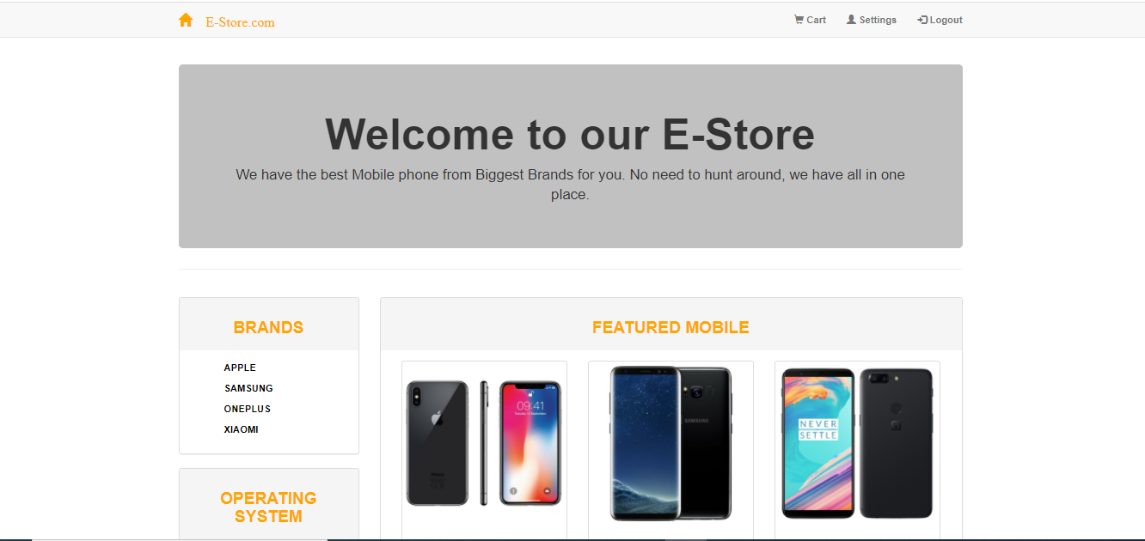
INDEX PAGE :

Slide 14
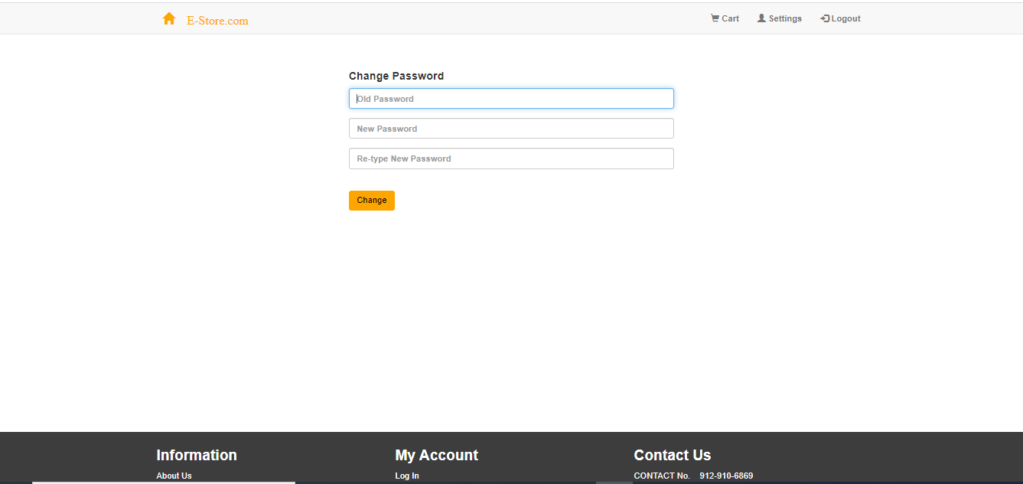
SETTINGS PAGE:

Slide 15
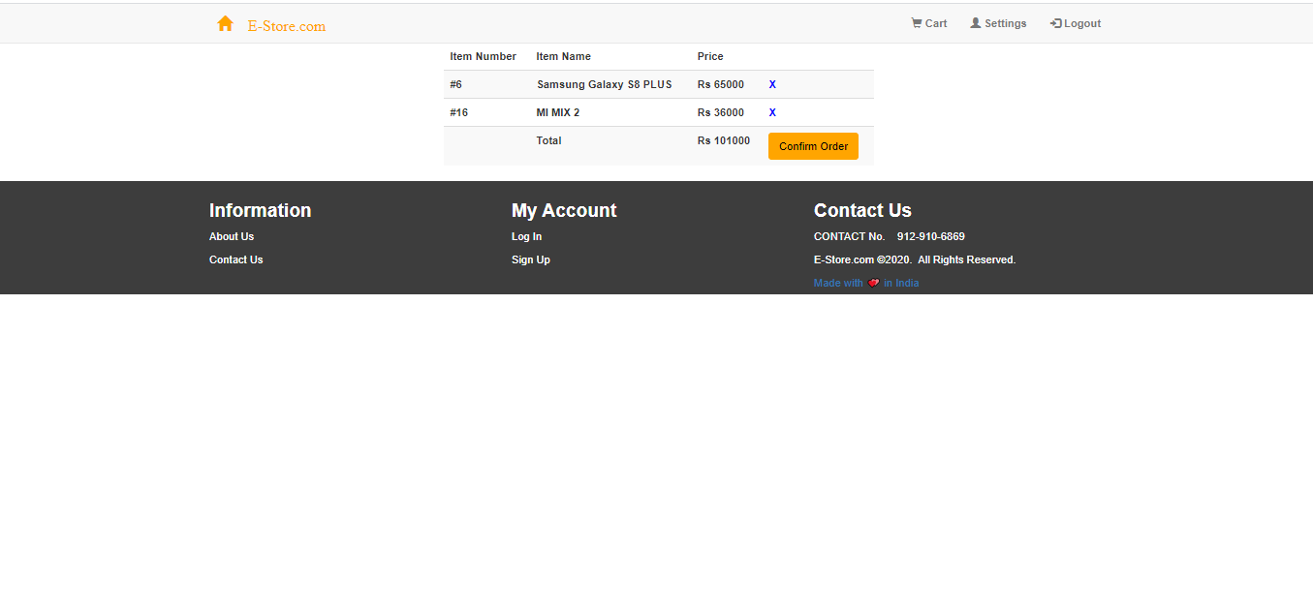
CART PAGE:

Slide 16
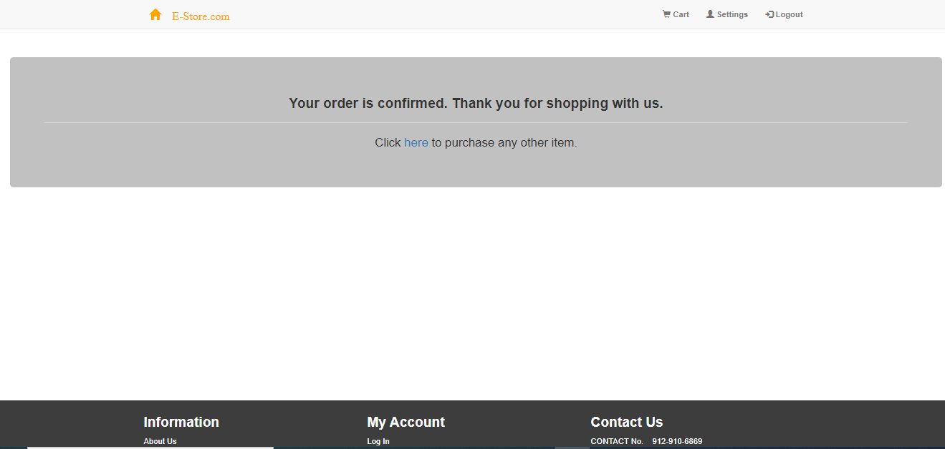
SUCCESS PAGE:

Slide 17
Conclusion
The above implementation resulted in a basic e-commerce website where a user can sign up, login, buy products and receive acknowledgement for the same.
Once the user is logged in, he/she cannot navigate to either the index page or the login page and is redirected to the home page. In this case, clicking on the logo from any page redirects the user to the home page.
The project is a classic example, that learning of concepts needs to be supplemented with application of that knowledge, without which knowledge remains incomplete.

Slide 18
LIMITATIONS
One of the most important limitations was the time period.
It doesn’t actually consider all the points that are required in real for a website.
Payment option is not a part of this website.

Slide 19
EXPERIENCE
It was quite interesting to see the things appearing on the front-end of the website with several validation codes running at the back-end.
Although I found it a bit challenging but exploring this domain was equally amazing.
The experience of working on Internshala was nice too.

Slide 20
THANK YOU

